Slide 1
Information for New Obstetrics Patients

Slide 2
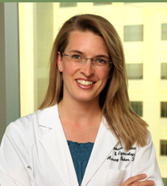
Meet our Providers
Dr. Schemmel
Dr. Reuter
Dr. Grant
Dr. Tyler
Dr. Spaniol
Amery Baker,
PA-C
Rhiannon Evans,
PA-C
Kali Arthurs,
PA-C

Slide 3
Table of Contents
Congratulations & General Info
Outline of Care
III. Nutrition
A. Diet During Pregnancy
B. Fish Consumption
C. Listeriosis
IV. Food Safety
V. Exercise
VI. Immunizations
VII. Bleeding
VIII. Medications
A. OTC Medications
B. Medications to Avoid
C. Herbal Tips
Optional Prenatal Risk Screening
The First Trimester
Frequently Asked Questions

Slide 4
Congratulations!
Thank you for trusting us with the care of your pregnancy.
We have a team of board certified physicians, and physicians assistants, who are committed to providing you with the best personalized care possible during your pregnancy.
*Visit our website for photos and bios of the providers, click here.
When it comes time for delivery, the physician on call from our office will perform the delivery. If you are having a scheduled Cesarean Section, you can choose a provider and we will do our best to accommodate you. You may choose to deliver at Sacred Heart Medical Center or Deaconess Hospital. Be sure to pre-register with the hospital of your choice about 6 weeks before your expected delivery.
At your next appointment we will review your maternity insurance benefits and answer any questions you may have. We will estimate your cost and create a monthly payment plan; so that balances will be paid prior to delivery.

Slide 5
Outline of Care
First Trimester
6-8 weeks:
Prenatal Labs
Review medical history
Full physical exam
11-13 weeks
Optional screening for down syndrome and spina bifida
Second Trimester
20 weeks
Fetal Anatomy Ultrasound
28 week
Gestational Diabetes Screening
Screening for Anemia
Rhogam Immunization (if needed)
Third Trimester
32 weeks
Whooping Cough vaccination (DTAP)
Labor and Delivery options discussed
Anesthesia information
36 weeks
Registration at Delivering Hospital
Testing for Group B Strep

Slide 6
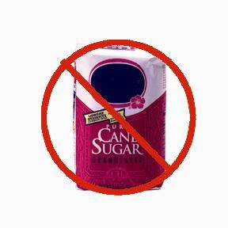
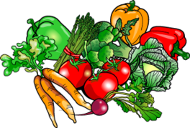
Diet During Pregnancy
The best diet for you and your baby includes lots of fruits, vegetables and whole grains, some low fat dairy products and a few sources of protein such as meat, fish, eggs, or dried peas or beans.
Aim for a high protein diet , approx. 80 grams a day.
Eat four servings of fruits and vegetables daily.
Limit refined sugars and white flour products. Whole grain products have more vitamins and fiber and are a better choice.

Slide 7
Diet During Pregnancy Cont.
Take your prenatal vitamins daily as directed, they are designed to fill in nutritional gaps.
Folic Acid, also know as folate, is a B vitamin that is important for pregnant women. 800 micrograms daily is recommended.
Pregnant women also require more Iron in their diet or by taking supplements, 27mg is recommended. This helps your body make more blood to supply oxygen to your baby.
Calcium helps build your baby’s bones and teeth. 1,000mg of calcium is recommended daily. Consider calcium supplements if you do not/can not eat enough dairy.
Vitamin D works with calcium to help baby’s bones and teeth develop. 600 IU (international units) of Vitamin D is recommended daily.

Slide 8
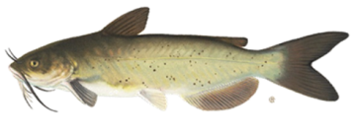
Fish Consumption During Pregnancy
Fish is a healthy part of diet in pregnancy. Some types of fish, however, can be harmful to a developing fetus. Fish that are high in mercury should not be eaten in pregnancy. Mercury has been linked to birth defects. Healthy fish include: Shellfish(such as shrimp), Salmon, Catfish, and Pollock. Do not eat: Shark, Swordfish, King Mackerel, or Tilefish. Limit white (albacore) tuna to 6 ounces a week. For more information see our chart on fish and pregnancy HERE.

Slide 9
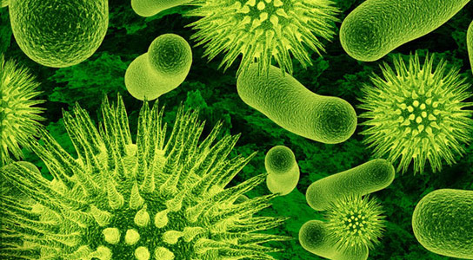
Listeriosis
Listeria Monocytogenes is a type of bacteria that is found in water and soil.
To prevent listeriosis, pregnant women should do as follows:
Do not eat unpasteurized cheese.
Do not eat hot dogs, lunch meats, or deli meats unless properly heated to 160 degrees.
Do not eat refrigerated pates or meat spreads.
Do not eat refrigerated smoked seafood unless it is in a cooked dish.
Practice safe food handling.
Symptoms of listeriosis may show up 2-3 days after exposure. Symptoms may include mild flu like symptoms, such as headaches, muscle aches, fever, nausea and vomiting.
Contact your provider if you experience these symptoms.

Slide 10
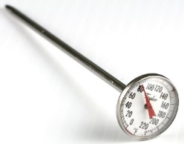
Safety Tips
4 Simple Steps to follow:
Clean- Wash hands thoroughly (before and after handling food, using restroom, changing diapers or handling pets).
Separate- Separate raw foods from ready to eat foods, do not place cooked foods on the plate that held raw foods, place cooked foods on a clean plate.
Cook- Cook foods thoroughly, use a food thermometer to check the temperature. Discard foods left out at room temperature for more than 2 hours. Avoid all raw and undercooked seafood, eggs, and meat. This includes sushi. Food such as beef, pork, or poultry should be cooked to a safe internal temperature."
Chill- Your refrigerator should register at 40 degrees F. Refrigerate or freeze perishables. Use ready to eat food as soon as possible.

Slide 11
Exercise During Pregnancy
When considering exercise, check with your doctor first!
Provided you are in good health and have no problems with your pregnancy you should be able to begin a reasonable exercise routine.
If you have been sedentary, choose an activity such as walking.
Pregnancy may affect how you exercise. Normal physical changes associated with pregnancy have a definite impact on movement and balance. You may have to change your normal exercise routine to accommodate for these changes.

Slide 12
Exercise During Pregnancy Cont.
Basic Guidelines
Regular sessions are better than sporadic activity.
Avoid outdoor exercise, when it is hot and humid.
Do a warm up and cool down routine. Stop when you are mildly fatigued.
Listen to your body.
Drink lots of water while exercising, as dehydration is a serious danger to you and your baby.
Do’s & Don’ts
Swimming is especially beneficial.
Yoga is great for strength, flexibility and familiarity with deep breathing.
Avoid jarring, bouncing, or activities that require precise balance.
Avoid sit-ups, toe-touches, and push-ups.
Contact sports are also not advised.

Slide 13
Immunizations
Vaccines in Pregnancy:
Influenza (flu) – Pregnant women and newborn babies can get severely sick with the flu. Getting the influenza vaccine will help to prevent this. It will also help your newborn baby from getting the flu in the first few months of life. Pregnant women should get the inactivated influenza vaccine, not the live vaccine.
Tetanus, diphtheria, and pertussis(whooping cough) –All pregnant women should get the tetanus, diphtheria, and pertussis vaccine at 27 to 36 weeks of pregnancy, even if they got it before.
Unsafe immunizations in pregnancy: Live influenza, MMR, Varicella(Chicken pox), HPV vaccine and Polio.

Slide 14
Bleeding
Bleeding during pregnancy is a disturbing but common experience. 1 out of 5 pregnant women will have some degree of bleeding. This does not always indicate a serious problem, but can be a warning sign of possible pregnancy loss or miscarriage.
Any cramping or bleeding should be reported to your physician, especially if they occur together.
If you should have spotting or bleeding do the following:
Go lie down and rest.
Call your doctor immediately if your bleeding is bright red and equal to or heavier than your normal menstrual flow.
Please keep in mind that not all bleeding indicates a serious problem or possible miscarriage.

Slide 15
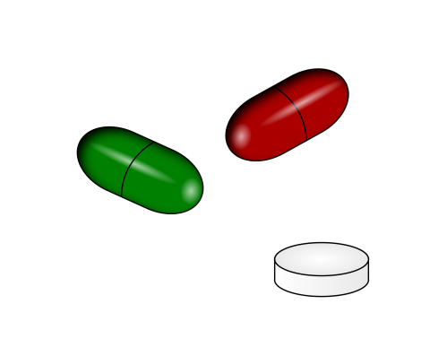
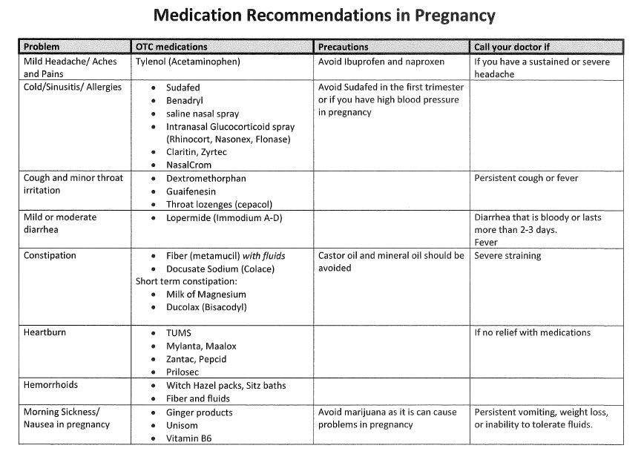
Medications
Over the Counter Medications
The following OTC drugs may be safely taken after 12 weeks gestation following all directions on the container for adult use.

Slide 16
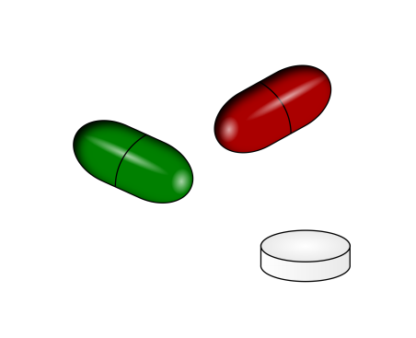
Medications Cont.
B. Medications to Avoid During Pregnancy
Avoid Aspirin, Aspirin-like compounds, Ibuprofen, Naproxen Sodium, and/or Naproxen. See Chart*:
Type of Medication | Medication Name Brand
Rx containing aspirin or aspirin like compounds | Darvon Compound, Disalcid Capsules, Easprin Tablets, Lortab ASA Tablets
Rx containing Ibuprofen | Motrin, Children’s Advil, Children’s Motrin
Rx containing Naproxen/Naproxen Sodium | Anaprox Tablets, Percodan Tablets, Soma Compounds
OTC-Drugs containing aspirin or aspirin like compounds | Some Alka-Seltzer products, Some Bayer products, Buffaprin Tablets/Caplets
OTC-Drugs containing Ibuprofen | All Advil products, some Bayer products, Midol, Motrin
OTC-Drugs containing Naproxen Sodium | Aleve, Bufferin, Ecotrin
*THIS IS NOT A COMPLETE LIST, ALWAYS CHECK LABELS OR CALL YOUR PROVIDER

Slide 17
Medications Cont.
C. Herbal Tips
The use of herbal remedies has grown but the FDA does not study herbs for harmful effects they may cause.
Some Potentially Harmful Herbs:
Borage
Calamus
Coltsfoot
Comfrey
Life root
Sassafras
Chaparal
Germander
Licorice
Ma huang
This is not a complete list, if you are considering using an herbal supplement, please check with your Provider first.

Slide 18
Marijuana and your Baby
Bottom Line – Marijuana is a harmful substance for pregnant women and their babies, despite the fact that it is legal in our State. It is not known how much exposure is dangerous, and no amount is considered safe.
Quick Facts
What in marijuana makes me feel “high”?
Tetrahydrocannabinol (THC) is the main ingredient in marijuana that is responsible for the effects of the drug.
Is marijuana safe for my baby if I don’t smoke it?
THC and the other chemicals in marijuana are still harmful to your baby, even if you use other methods of consumption such as edibles or vaporizers.
Is marijuana safe if I am breastfeeding my baby ?
THC can accumulate very easily in breast milk. This is because it is stored in fat, and there is a lot of fat in breast milk. This means it will still be passed on to your baby. THC is not broken down quickly by the body, and so the “pump and dump” technique will not work like with alcohol.
What effects can smoking marijuana have during pregnancy?
Several studies have shown a wide range of effects of marijuana in pregnant women. One of the biggest risks is an increase in the risk of having a low red blood cell count (anemia). Other, smaller studies have shown an increase in preterm labor.
What are the risks of smoking marijuana for my baby?
There are numerous well documented effects of marijuana on unborn babies. These children have a lower birth weight and slower development of physical and mental skills. Babies exposed to higher levels have been shown to have a mild withdrawal syndrome.
As these children get older, they have been shown to have difficulty paying attention in school and have decreased cognitive abilities.
Is smoking marijuana safe if I am trying to get pregnant?
Marijuana is NOT safe for women trying to become pregnant. Studies in humans have suggested that higher levels of the active ingredients in marijuana may lead to a higher rate of ectopic pregnancies. It has also been shown in mice that increased levels of these ingredients may affect how fertilized eggs implant into the uterus. Marijuana can also decrease male sperm count and make becoming pregnant more difficult.
For more information or help quitting, visit one of the sites below or talk to your doctor.
http://www.doh.wa.gov/YouandYourFamily/Marijuana
https://www.warecoveryhelpline.org/ or call 1.866.789.1511

Slide 19
Alcohol, Smoking and Illicit/Recreational Drugs
Alcohol can cause intellectual disability, fetal alcohol syndrome and other deformities if used during pregnancy and is not recommended.
Smoking tobacco has many risks with pregnancy, including preterm delivery and smaller babies. Infants born to mothers who smoke are more likely to have asthma, colic, and childhood obesity. They also are at increased risk of dying from sudden infant death syndrome (SIDS).
All illicit/recreational drugs can cause side effects to your pregnancy and baby, therefore they are not recommended. This includes marijuana, methamphetamines, cocaine, heroin, and prescription drugs not used as prescribed.

Slide 20
Optional Prenatal Risk Screening
Screening for Downs Syndrome and/or Spina Bifida
There are two options for screening:
Integrated screening: A non-invasive test to tell you if your baby is more likely to have Down Syndrome, trisomy 18 or spina bifida. This includes: Ultrasound at 11-13 weeks Blood draw with US at 11-13 weeks and again between 16-20 weeks. Test results are available after the second blood drawn.
Non-invasive prenatal testing (NIPT): This is a non-invasive blood test analyzing the chromosomes of the baby. This test can be done anytime in pregnancy after 9 weeks. This test will also tell you the gender of your baby.
The risk of Downs Syndrome increases with the age of the mother, with women over 35 being at more risk. Downs Syndrome is not genetic so a family history of the condition does not increase your risk of having a baby with Downs Syndrome.

Slide 21
Optional Prenatal Risk Screening
Cystic Fibrosis testing: Cystic Fibrosis is a genetic condition that can affect the lungs and digestive system. 1 in 25 Caucasians are carriers of cystic fibrosis. The testing is to determine if you are a carrier. If positive we will test the father of the baby.
Spinal Muscular Atrophy (SMA):
Spinal Muscular Atrophy is a childhood condition that causes worsening muscle weakness. It occurs in 1 out of 10,000 births each year. 1 in 47 people are a carrier of the condition.
Both Cystic Fibrosis and SMA are genetic conditions, which means that they are passed on for generations. Most people, however, are not aware that they are carriers as it can be passed on for generations without symptoms.

Slide 22
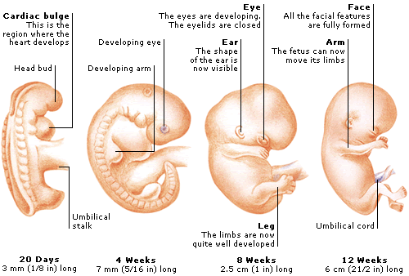
First Trimester
During the first three months(weeks 1-12) of pregnancy you may experience these symptoms:
Stopped period
Enlarged tender breasts
Protruding nipples
Frequent urination
Fatigue
Nausea
Food cravings
Lost appetite
Heartburn & indigestion
Constipation
Bloating
Change in weight, plus or minus

Slide 23
Frequently Asked Questions
Hair Color?
It is believed that hair dyes are most likely safe to use during pregnancy since very little is absorbed by the skin. It is advised to use a well ventilated area and inquire about chemicals if you are concerned.
Travel?
Travel is usually no risk to you or baby. However, you should not plan to travel long distances the last 4-6 weeks of pregnancy and may be restricted earlier if you have a high risk pregnancy. With recent Covid- 19 concerns, please check with the CDC for foreign travel recommendations.
Hot tubs/Saunas?
Very hot water and steam should be avoided, especially during early pregnancy. Avoid immersing your entire body into the hot tub. Saunas should be avoided.
Sex and Pregnancy?
Unless your obstetrician instructs you otherwise, sex is safe throughout your pregnancy.
Seat Belts?
Seat belts (shoulder & lap) are safety devices to protect you, place the lap belt under your belly, across your hips and thighs.

Slide 24
For more information please visit our website at spokaneobgyn.com, or click here.

